Slide 1
Handwritten to Computer Written
A text recognition implementation
Justin Lin Sin Cho
Computer Vision 4220U
Ontario Tech University

Slide 2
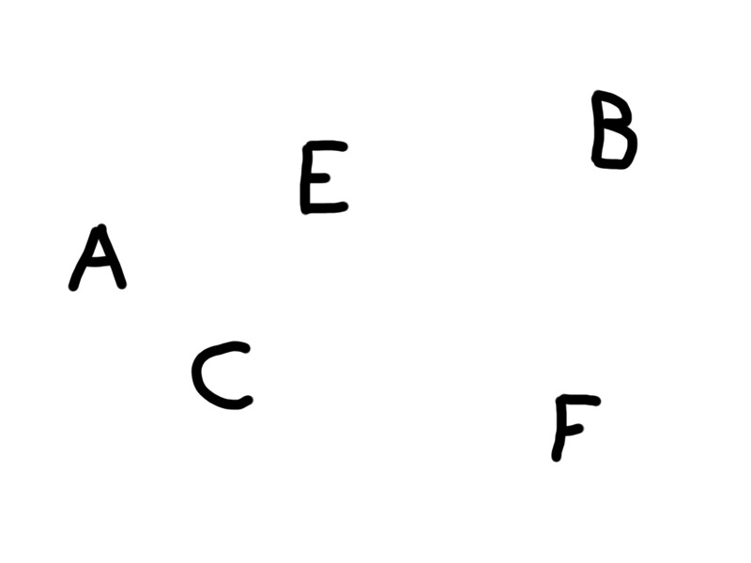
Dilemma
How to extract the text from a picture of handwritten information?

Slide 3
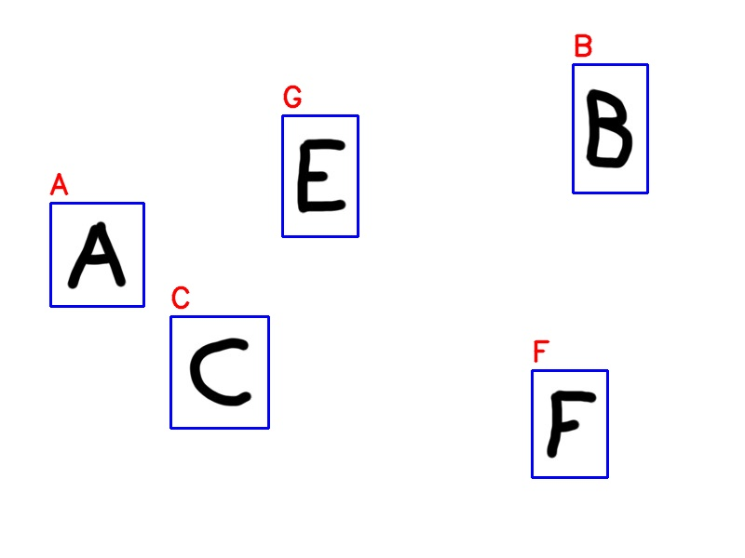
Solution: Text recognition software
Teach a computer to recognize text on its own

Slide 4
Program Pipeline
Image processing
Feature detection & cropping
Loading the dataset
Designing a model & fitting the data
Making a prediction

Slide 5
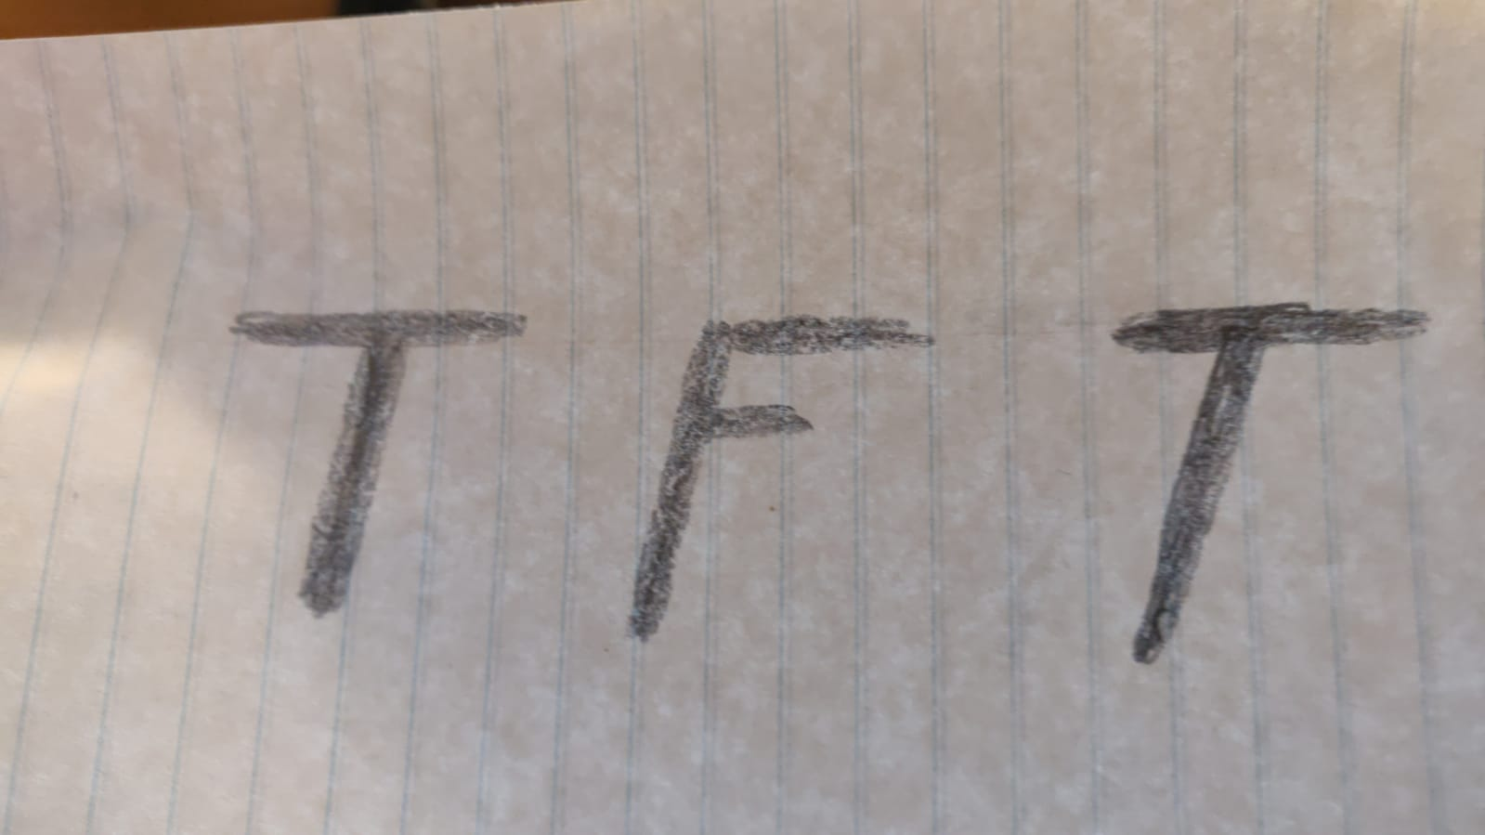

Image processing
Images can be noisy and contain undesired information
Colour to greyscale
Thresholding
Bilateral filtering

Slide 6
Image processing
Images can be noisy and contain undesired information
Colour to greyscale
cv2.cvtColor(img, cv2.COLOR_BGR2GRAY)
The colour of a character may not be important to text recognition
Thresholding
Bilateral filtering

Slide 7
Image processing
Images can be noisy and contain undesired information
Colour to greyscale
Thresholding
cv2.threshold(imgray, 127, 255, cv2.THRESH_BINARY)
Hazy gradient background can make unclear picture
Bilateral filtering

Slide 8
Image processing
Images can be noisy and contain undesired information
Colour to greyscale
Thresholding
Bilateral filtering
cv2.bilateralFilter(thresh, 15, 75, 75)
Smooth noise while maintaining edges

Slide 9
Feature detection & cropping
Tasks
Need to be able to detect text based from a picture.
Need to be able to crop the picture to send to model

Slide 10

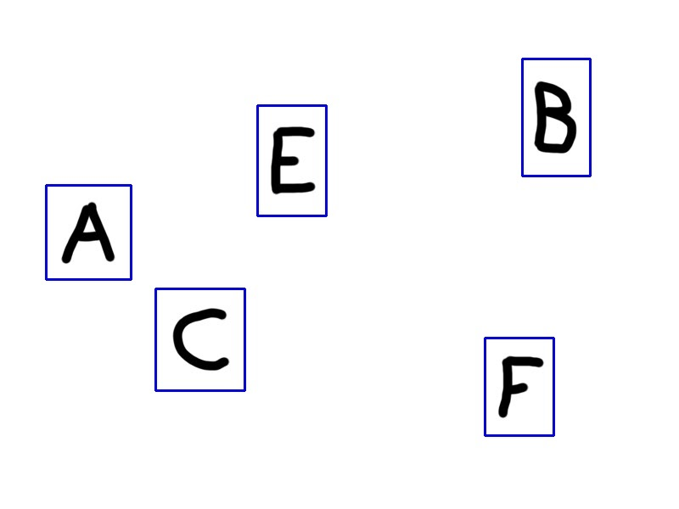
Feature detection & cropping
Simple with OpenCV findContours
cv2.findContours(img, cv2.RETR_TREE, cv2.CHAIN_APPROX_SIMPLE)
For x in range(len(contours)):
[x, y, w, h] = cv2.boundingRect(contours[x])
cv2.rectangle(img, (x, y), (x + w, y + h), (255, 0, 0), 2)

Slide 11
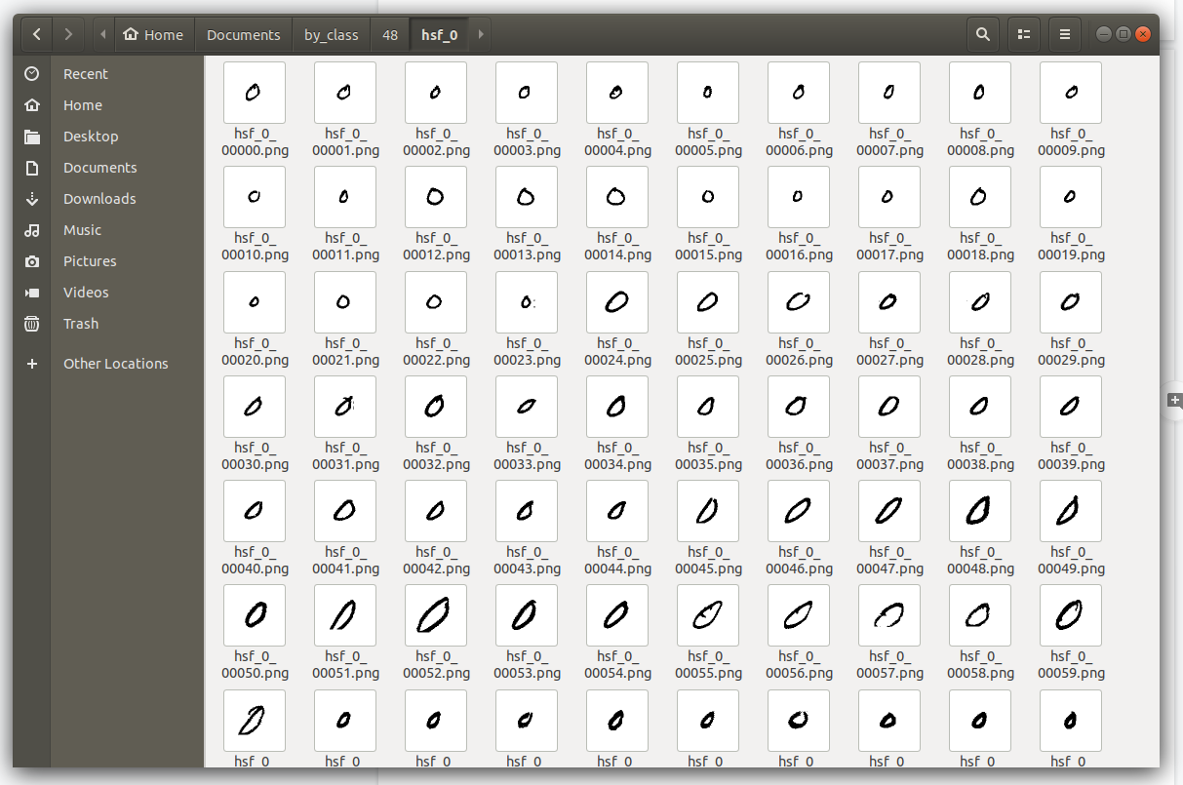
Loading the dataset
A machine learning model needs tons of data to learn
Using the NIST dataset
https://www.nist.gov/srd/nist-special-database-19

Slide 12
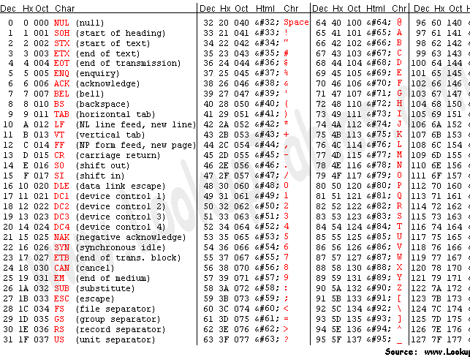
Loading the dataset
Training data
X_train = normalized image
Y_train = ascii equivalent integer

Slide 13
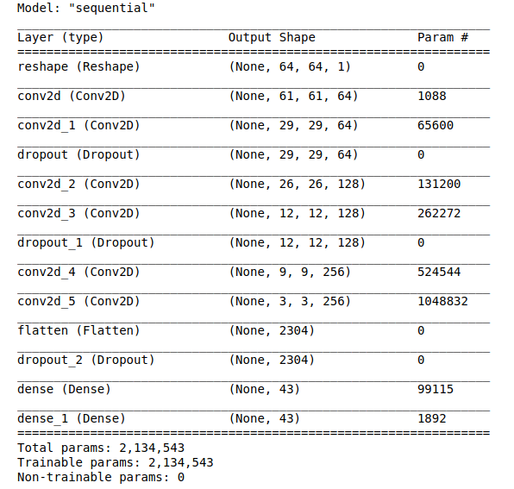
Designing a model
Using the keras model from Tensorflow
Adding layers to the model
Deciding on a loss function depends on the model use and output (example: classification to a single integer, sparse_categorical_crossentropy)

Slide 14
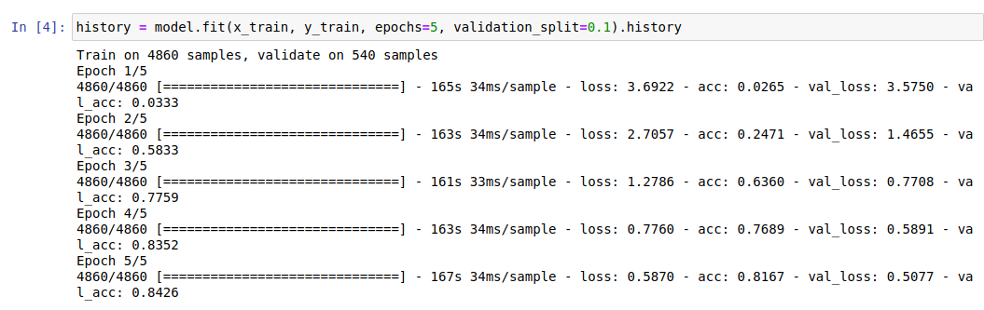
Fitting the model
The model needs to learn from data
Using 5 passes or “epochs”
Using 10% of the data as validation_split
Nearly 15 minutes for just 5 passes!

Slide 15
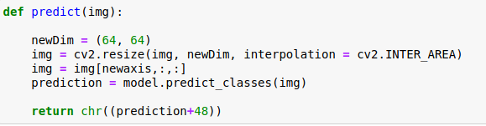
Making a prediction
All this work, for what?
Using the model to evaluate pictures and make a prediction on the value

Slide 16

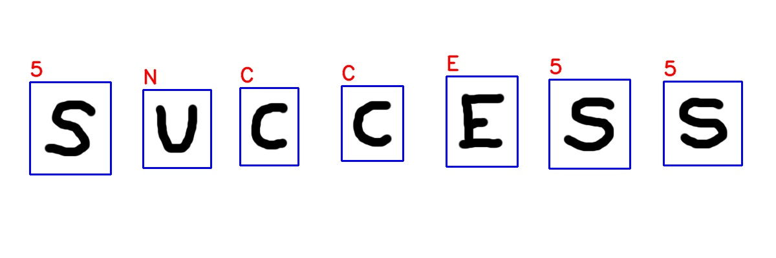
The culmination
Success!
…sort of

Slide 17
Just the start
We have a semi-working text recognition system but this isn’t the end! We need to work on what we can improve and polish.
Create a more robust system to noise
More accurate text detection
Different rotation of texts
Text wrapping around physical objects
Real time text recognition in video
Different fonts
Different language characters

